Slide 1

Amazon Guard Duty
Presentation by:
S.Suresh
CloudSIKSHA

Slide 2
AWS GuardDuty
Amazon GuardDuty is a continuous security monitoring service that analyzes and processes the following data sources:
VPC Flow Logs
AWS CloudTrail event logs
DNS logs
It uses threat intelligence feeds, such as lists of malicious IPs and domains, and machine learning to identify unexpected and potentially unauthorized and malicious activity within your AWS environment
This can include issues like escalations of privileges, uses of exposed credentials, or communication with malicious IPs, URLs, or domains

Slide 3
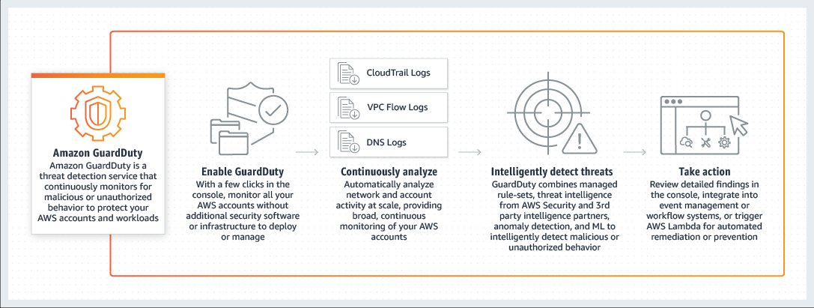
AWS GuardDuty

Slide 4

AWS GuardDuty Data Sources
CloudTrail
VPC Logs
DNS Logs

Slide 5

Thank you

